Slide 1

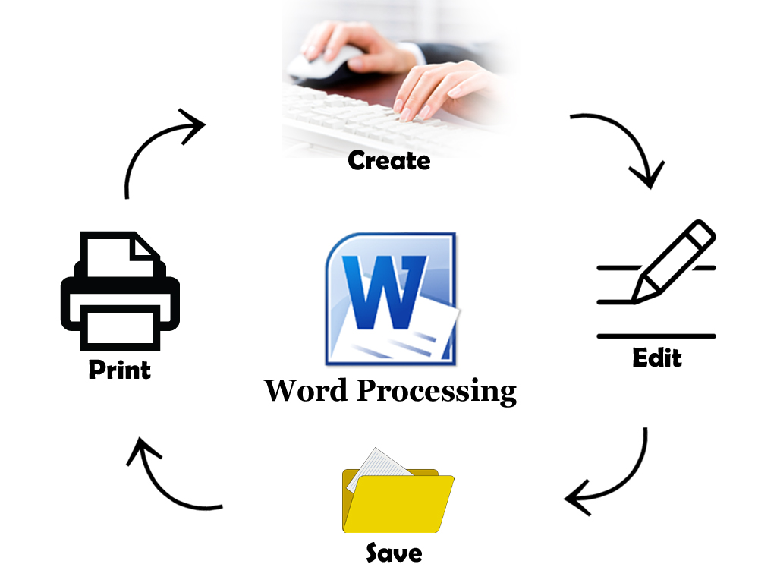


Word
Processing
Class V
lab 13

Slide 2



MS Word
Microsoft Office Word allows you to create and edit personal and business documents

Slide 3
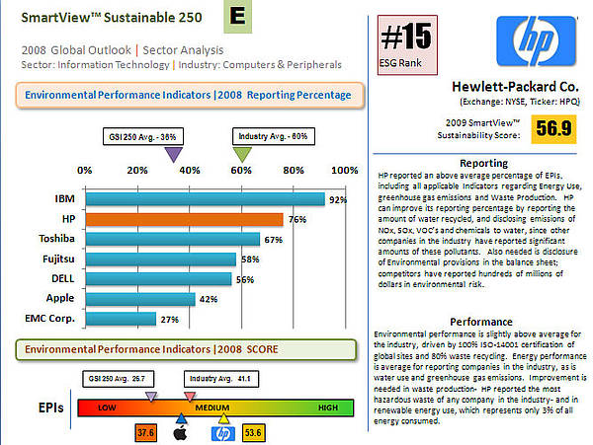
For Making Report
word is used to make business report

Slide 4
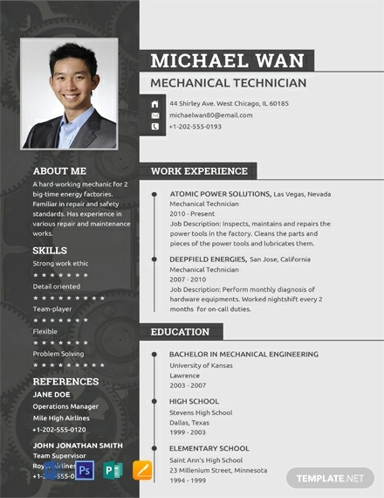
For Making Resume
word is used to make resume

Slide 5
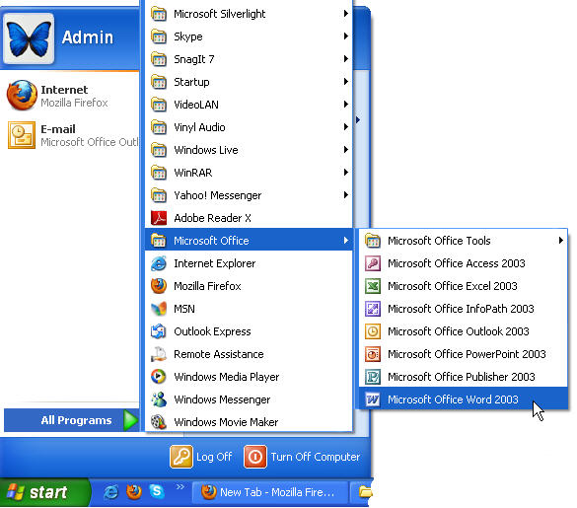
How to Open
Step 1: From the desktop or from your ‘Start’ menu, open Microsoft Word.

Slide 6


